Slide 1

MOMmy, Help My LaunDRY!
Final Presentation
Team 8

Slide 2
01
Motivation & Proposed Idea
02
Use Cases & Key Functions
CONTENTS
03
System Architecture Overview
04
Key Technical Challenges
& Solutions
05
Evaluation
06
Project Management & Success Criteria

Slide 3
01
Motivation & Proposed Idea

Slide 4
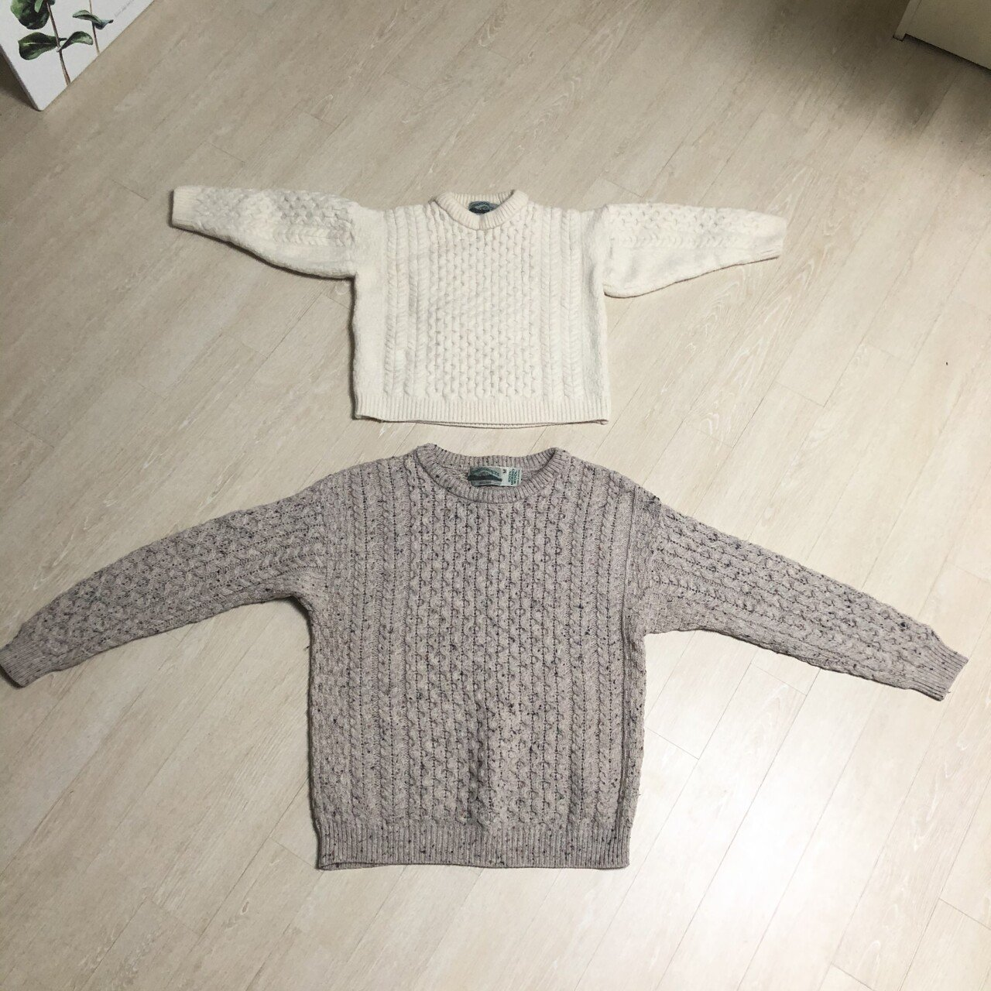
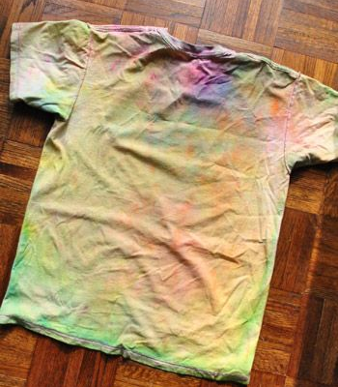
Motivation
When you live alone, doing laundry is often difficult
Many things to consider
Fabric, color, machine or dry-cleaning?
What do the labels mean?
Be careful! Your clothes end up like this…
Notes:
This is the motivation of the project.
When you leave alone it is hard to do laundry.
Because there are so many things to consider and it is difficult to understand the care labels on the tag.
Therefore, we focus on giving people the chance to do laundry easily by giving information and guidance.

Slide 5
Proposed Idea
General Idea
Give users guides for doing laundry
Store users’ data and retrieve data whenever needed
All care labels and the corresponding information
Target users
People who live alone
Novelty
Existing applications only target laundry outsourcing services
We help people to do laundry themselves (cheaper)
Notes:
Our idea is to give users guides for doing laundry
To give them information, we should be able to store user’s data and reload the data
The data includes user’s clothes name and corresponding care labels.
Existing services related to laundry only includes laundry outsourcing applications.
Those applications are comfortable and useful.
But for the people living alone might feel unaffordable.
Therefore, our team made application called “Momdry” that interpreting care labels and helping people to do laundry by themselves

Slide 6
02
Use Cases
&
Key Functions

Slide 7
Use Cases (Recap)
People who do not know about care labels
The app provides laundry tips for them
Labels on clothes washed away after using the app one or more times.
The app saves and recovers laundry tips for users’ clothes
Notes:
There are two main use cases
First people who do not know about the care labels on the tags of the clothes.
For them, we will provide laundry tips.
Second, if the tag of the cloth is washed away, there is no way people can find out how to wash the cloth.
Our application will save the data so that people can reuse it as long as they want.

Slide 8
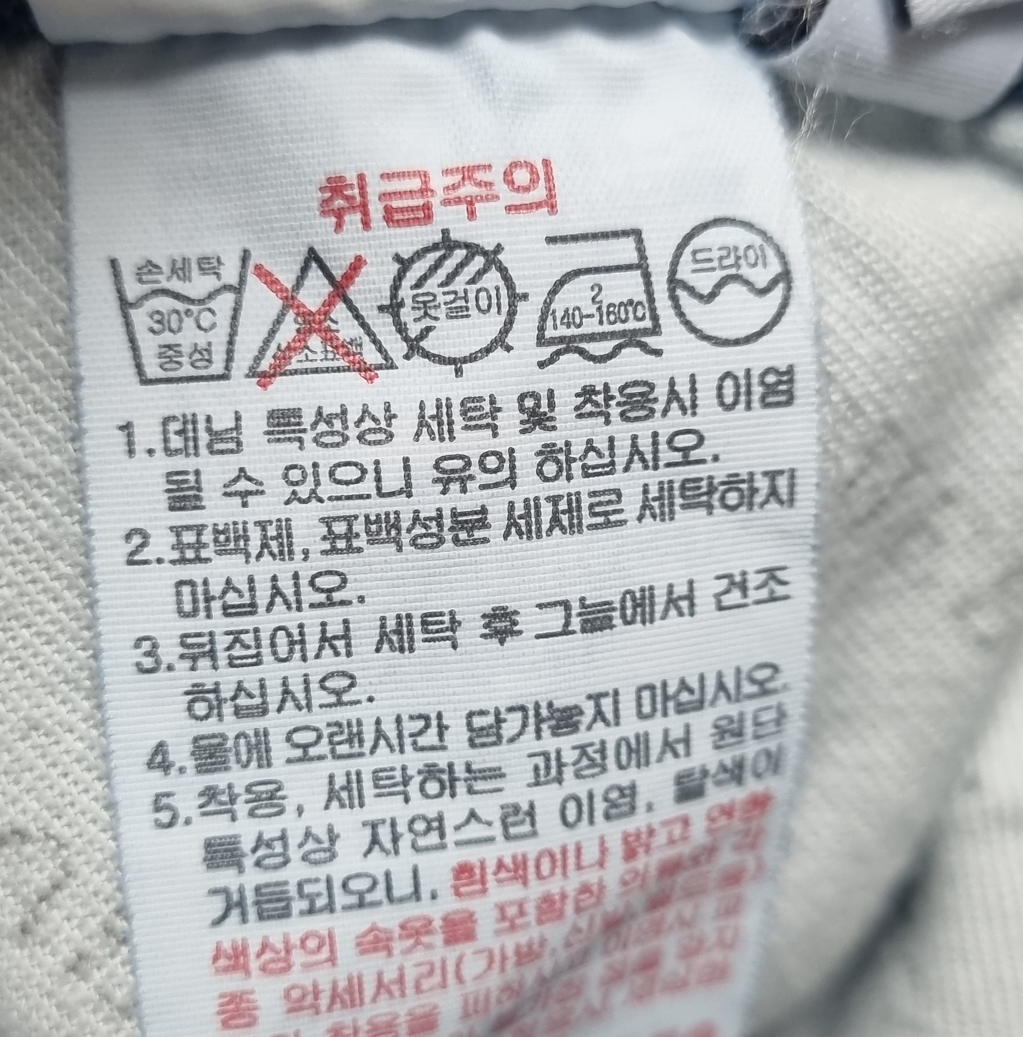
Key Functions
Recognize care labels using camera and object detection model
Store care labels of the cloth
Name: “My favorite Sweatshirt”
Labels:
NoWater: Do not use water
Bleach_O: Do not use bleach
Iron_O: Can use iron
Dryclean_O: Must be dry-cleaned
Shade: Dry under shade …
&
Name: My favorite Sweatshirt
STEP 1 >
Take a picture of clothes and their care labels.
STEP 2 >
By using object detection model, detect washing symbols in care label.
STEP 3 >
Collect types of care labels and name(or type) of cloth
STEP 4 >
Store the data into the User Cloth DB
Notes:
The first key function of our application
is to detect care labels of the cloth and provide information on them.
In order to do this, we will use ML model to detect objects which are care labels from the camera
and using pre defined variables and information, we will collect all care label information from the picture.
After successfully collecting the information we will save them into the database.

Slide 9
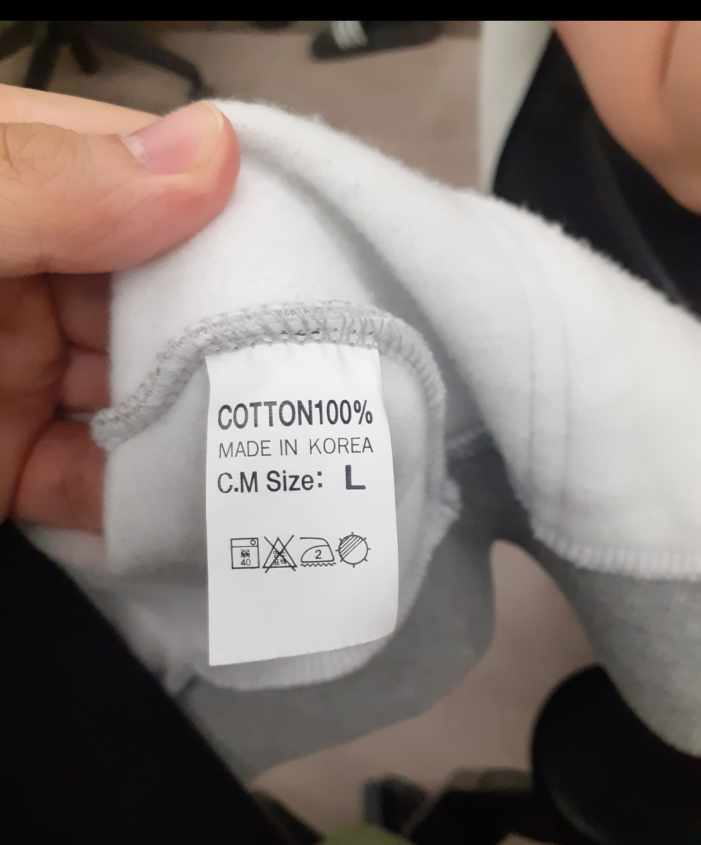
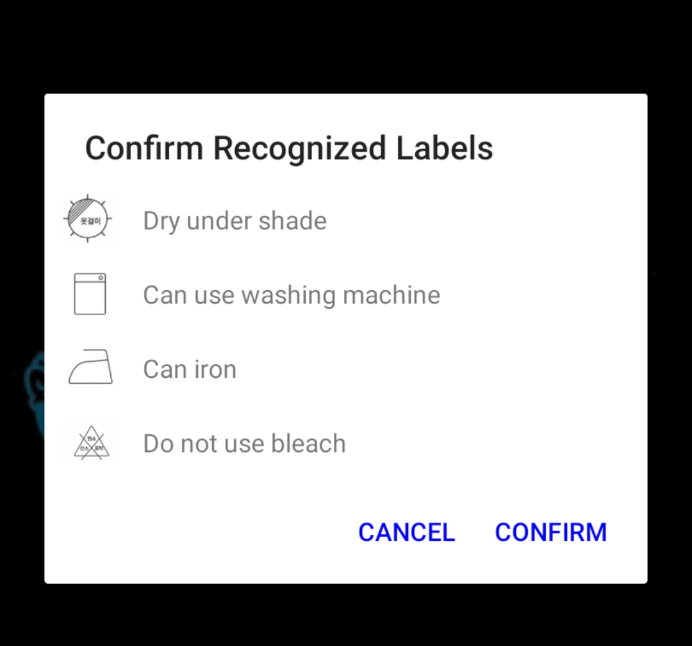
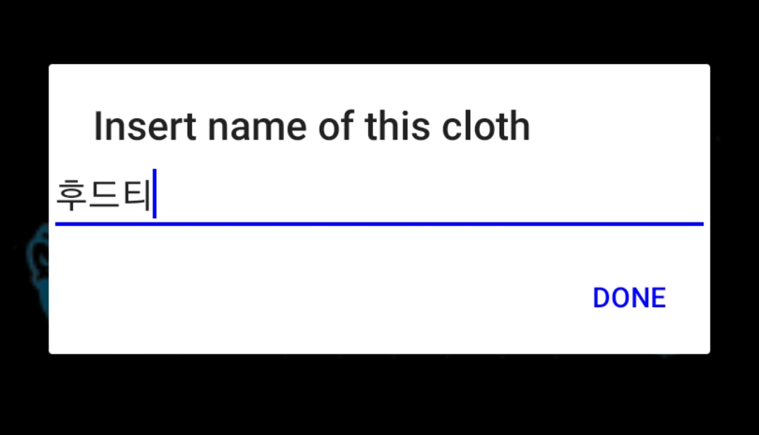
Key Functions
Recognize care labels using camera and object detection model
Store care labels of the cloth
Picture
Detected labels
Naming
STEP 1 >
Take a picture of clothes and their care labels.
STEP 2 >
By using object detection model, detect washing symbols in care label.
STEP 3 >
Collect types of care labels and name(or type) of cloth
STEP 4 >
Store the data into the User Cloth DB
Notes:
The first key function of our application
is to detect care labels of the cloth and provide information on them.
For this, user take a picture of a care labels.
As you can see in the middle,
By using object detection model, our application can detect washing symbols in care label and give information about it.
After that, user put the name of that clothes.
Then the data is stored to the User’s Cloth DB.

Slide 10
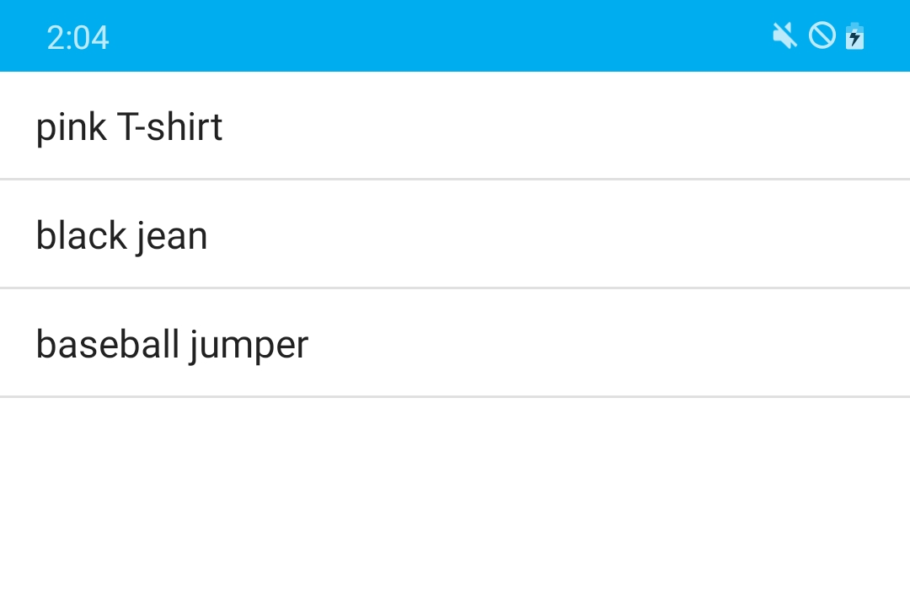
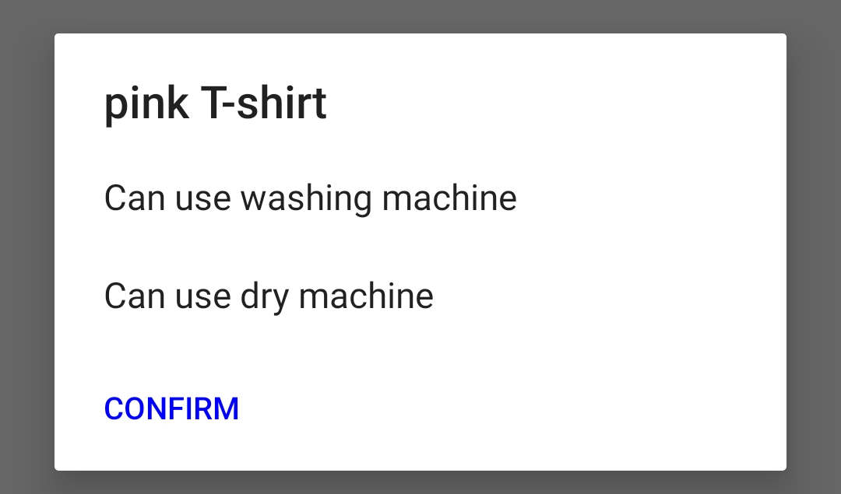
Key Functions
Get guidance of stored clothes from DB
Click!
STEP 1 >
Get list of stored clothes
STEP 2 >
Select one of them
STEP 3 >
User can get washing guidance of stored clothes
Notes:
If database successfully stores the user information, user can reload the data as a list.
so by just selecting the clothes name, user can get corresponding care label information.

Slide 11
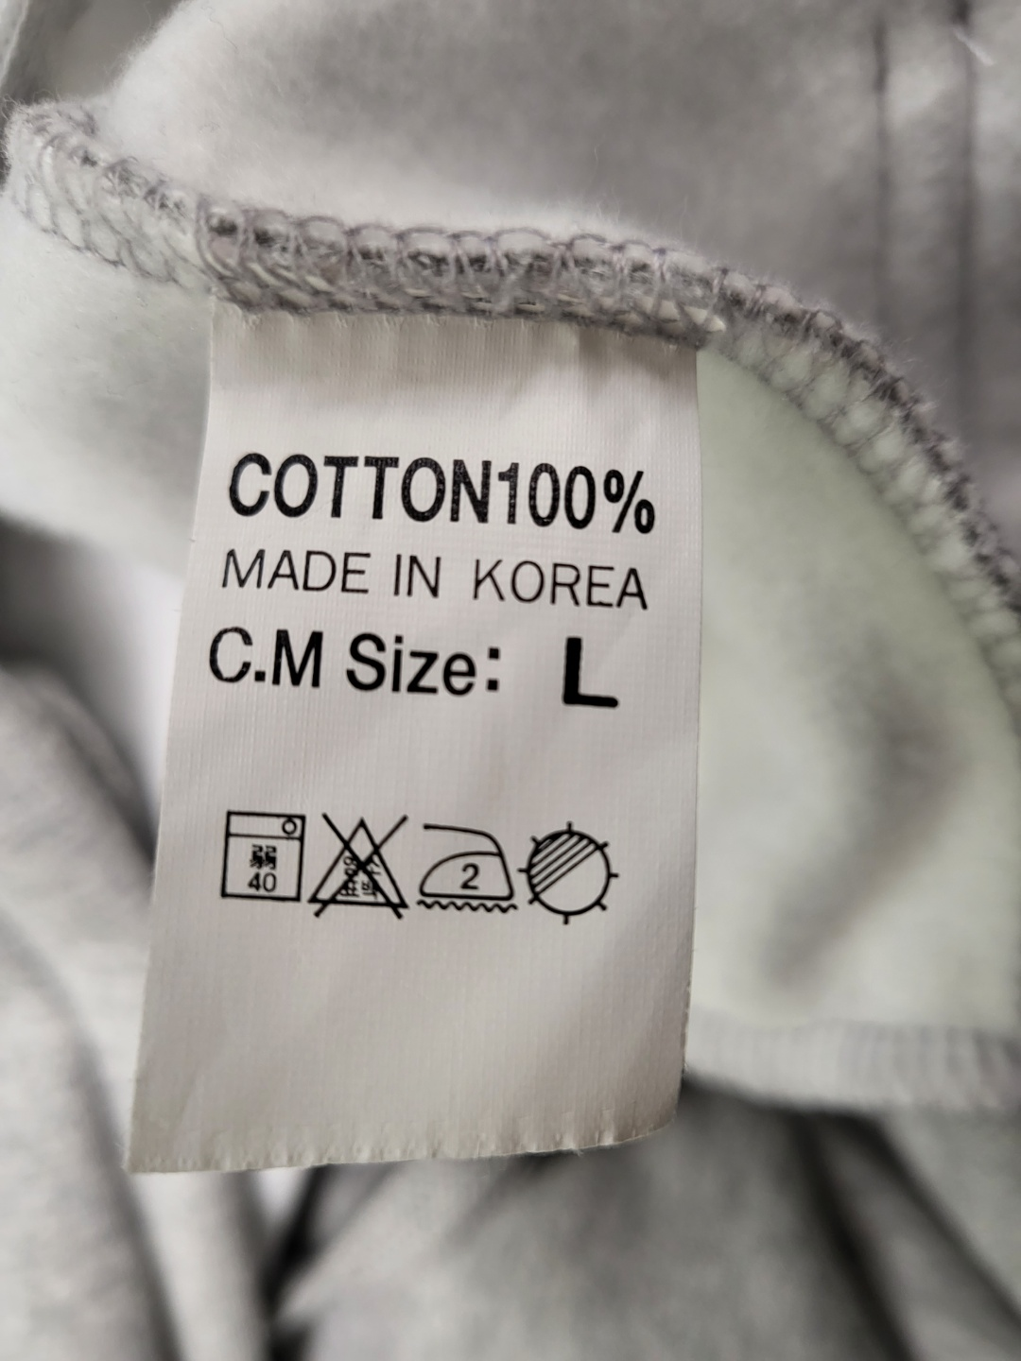
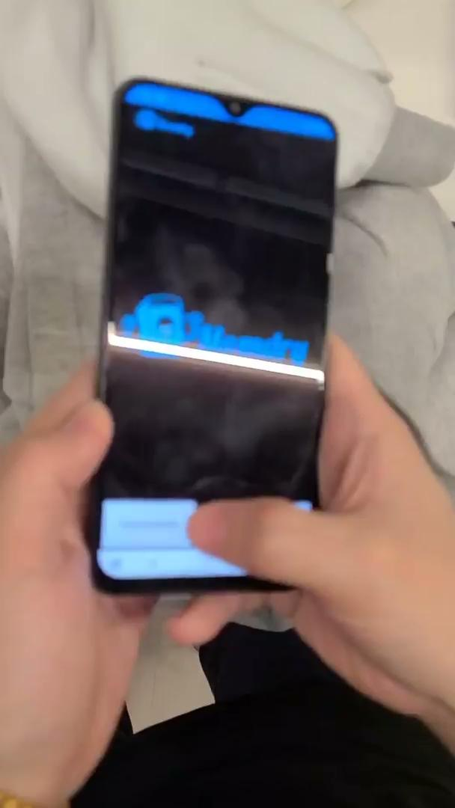
OUR Final Demonstration

Slide 12
03
System Architecture Overview

Slide 13
System Architecture
Input (Camera)
Image from Camera
User Cloth Presenter
Trigger DB to show all registered user cloth data
Label Recognizer
Extract guidance IDs from input image (object detection trained by us)
Cloth Name Recorder
Record name of cloth image data from camera
User Cloth DB Manager (& DB)
Store registered user clothes and care label data in the database
Presenters (registered list & guidance)
Print list of clothes registered
Print guides for selected cloth
Image Input
(Camera)
User Cloth Presenter
(Menu)
Care Label Recognizer
Cloth Name Recorder
User Cloth DB Manager
User Cloth DB
Registered List
Presenter
Guidance Presenter
Changes from mid presentation
Combined DB Manager for user cloth & care labels
Removed cloth type recognizer
Control Flow
Notes:
This is our final system architecture.
As an input, we get image from camera.
and then, care labels are detected by our object detection model.
Care label recognizer will then detect the care labels form the image.
Also we will get the cloth name from user to get text name.
With labels and name, we can identify the unique cloth and we can save the data altogether to the database.
Saving and reloading the data is handled by User cloth DB manager.
Whenever user requests the cloth data, the DB manager will access the DB to retrieve the information.
Finally using the UI such as User Cloth, List, and Guidance presenters,
we can visually show the stored clothes and laundry tips for each of the clothes to users.

Slide 14
System Architecture
Input (Camera)
Image from Camera
Picture loader
Load taken picture and transfer it to recognizer
Label Recognizer
Extract guidance IDs from input image (object detection trained by us)
Cloth Name Recorder
Record name of cloth image data
User Cloth DB Manager (& DB)
Store registered user clothes and care label data in the database
Presenters
Print list of clothes registered
Print guides for selected cloth
Image Input
(Camera)
Picture loader
User Cloth Presenter
(Menu)
Label recognizer
Cloth Name Recorder
User Cloth DB Manager
Guidance Presenter
Control Flow
Notes:
This is our final system architecture.
And it shows the control flow of first key function
As an input, we get image from camera.
Then picture loader will take the captured image and feed it to the label recognizer.
The label recognizer which is object detectio model will detect care labels
Then cloth name will be typed by user.
With labels and name, we can identify the unique cloth and we can save the data altogether to the database.
Saving and reloading the data is handled by the DB manager.
Whenever user requests the cloth data, the DB manager will access the DB to retrieve the information.
Finally using the UI presenters,
we can visually show the stored clothes and laundry tips for each of the clothes to users.

Slide 15
System Architecture
User Cloth Presenter
Trigger DB to show all registered user cloth data
User Cloth DB Manager (& DB)
Store registered user clothes and care label data in the database
Presenters
Print list of clothes registered
Print guides for selected cloth
Image Input
(Camera)
Picture loader
User Cloth Presenter
(Menu)
Label recognizer
Cloth Name Recorder
User Cloth DB Manager
Guidance Presenter
*Changes from mid presentation
Combined DB Manager for user cloth & care labels
Removed cloth type recognizer
Control Flow
Notes:
When data is already stored and user wants to reload the same data once again,
Cloth presenter will be triggered and it requests the DB manager for accessing data.
By accessing the DB, DB manager will load all the clothes and their corresponding care label data from the DB.
Using the data from the DB, guidance presenter will show laundry guide for each care label.

Slide 16
04
Key Technical Challenges
&
Solutions

Slide 17
Challenges & Solutions
Challenge 1. Object detection accuracy is limited
Object detection cannot be 100% correct
We need some logic to support object detection
Solution. Double check detected labels by users
Show reference image of detected labels
User can check that the detected images are same with references
Notes:
The first challenge was limited accuracy of object detection model.
As you guys might know, object detection cannot be 100 percent correct.
We need some additional logic to support object detection.
So we add the function to let user double check the detected labels
After label detection, app shows reference images of detected labels.
User can check that the detection is correct.
If the detection is wrong, app do it again from the first step.

Slide 18
Challenges & Solutions
Challenge 2. It is difficult to recognize user’s cloth using pictures
cloth recognition need another model
cloth recognition is more complex than label detection
detailed recognition like fabric texture or user context
model training cost is too expensive
retrain when new cloth added
one model for each user
Solution. Use user-labeled name to identify clothes
User specify name of the cloth after label detection
User can access guidance of the cloth using the name
User can choose to save the cloth or not
Notes:
The other difficult thing was recognizing user’s cloth by picture.
Cloth recognition is needed for our the second key function.
The problem is that we need another more complex model for this recognition.
The model training cost was also expensive.
We need one model for each user and retraining when new cloth added.
Our solution is using user-labeled name.
User specify a name of a cloth after label detection
and access its guidance using the name at anytime.
Using cloth name, we can serve the second use case without cloth recognition.

Slide 19
05
Evaluation

Slide 20





Evaluation
Final Demo
Accuracy
Limited accuracy (More dataset required)
Double check by users
Latency
Human-unrecognizable Latency (Seamless Service)
Durability
Data persistence on shutdown or crash
Notes:
This is evaluation of our project
Accuracy is limited, but we let users check detected result to support limited accuracy.
Latency is fast enough to provide service without blocking.
We also checked that our app maintain user data in the case of shutdown.

Slide 21
Limitation
Limited accuracy
collect more dataset
User manually label the cloth name
User can forget about the name
Add cloth pictures to DB
but we thought user can feel uncomfortable to take additional picture to save it
Notes:
We have two limitation.
One is limited accuracy.
To solve this limitation, we need much more dataset.
The other is that user “manually” label the cloth name.
User can forget about the mapping of name and cloth.
One possible solution for this is adding cloth pictures in DB not only its name.
But it also make user feel uncomfortable.

Slide 22
06
Project management & Success criteria

Slide 23
Project Management (Mid)
Done | JOBS | Mar. ~ 22 (Proposal) | Mar. 23 ~ 31 | Apr. 1 ~ 10 | Apr. 11 ~ 20 | Apr. 21 ~ 30 | May 1 ~ 5 (Milestone 2)
V | Prepare Proposal | JY, DK, IH, MJ
V | Presenter(GUI) module design |  | JY, IH
V | DB manager design |  | DK, MJ
V | Label recognizer module design |  | JY, DK, IH, MJ
V | Presenter implementation |  |  | JY, IH
V | DB manager implementation |  |  | DK, MJ
V | Label recognizer implementation |  |  | JY, DK, IH, MJ | JY, DK, IH, MJ
V | Presenter verification |  |  |  | JY, IH
V | DB manager verification |  |  |  | DK, MJ
V | Integration and test |  |  |  |  | JY, DK, IH, MJ
V | Prepare Mid. Demo |  |  |  |  |  | JY, DK, IH, MJ
Notes:
This is our project schedule until midterm

Slide 24
Project Management (Final)
JOBS | Member
Picture loader design and implementation | MJ
User guided label recognition design and implementation | JY, IH
User data manager design & implementation | DK
Overall GUI | JY
Total module integration and verification | JY, MJ, DK, IH
Prepare Final Demo | JY, MJ, DK, IH
Notes:
This is what we do for our final demo.
We design and implemented
picture loader, label recognition, data manager and GUI.

Slide 25
Lesson learnt
Great time to experience AI application
TFLite provides user-friendly functionalities.
Making android application is quite complicated
Model accuracy cannot be 100%,
Additional logic is necessary to support limited accuracy
Notes:
This is what we learned
It was great time to experience AI application.
TFLite and android studio provides user-friendly functionalities.
But making android application is quite complicated for us.
We learned that even model is very accurate, it cannot be 100%.
Additional logic to support limited accuracy is necessary.

Slide 26
07
Q&A
Notes:
This is all we prepared today.
Thank you for listening and please ask any question if you have.

Slide 27
THANK YOU

Slide 28
Backup slides

Slide 29
System Overview
Input
Image
Instant input from Camera
Input from existing image file
User Selection
Selection among registered clothes
Recognizers
Extract guidance or cloth IDs from input image (pre-trained by us)
DB Managers
Provide stored information from indexes
Presenters
Print out information to screen
Image Input
(Camera, image files)
Cloth Selector
Care Label Recognizer
Cloth
Recognizer
Guidance DB Manager
User Cloth DB Manager
Guidance DB
User Cloth DB
Guidance Presenter
Registered List
Presenter
Control Flow

Slide 30
Final Deliverable and success criteria
Laundry guide application
Recognition & give correct laundry guide
clothing image recognition
- care label recognition

Slide 31

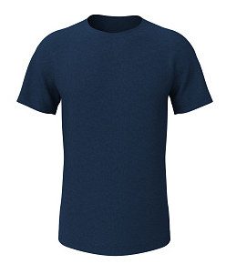
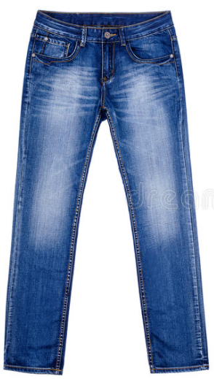
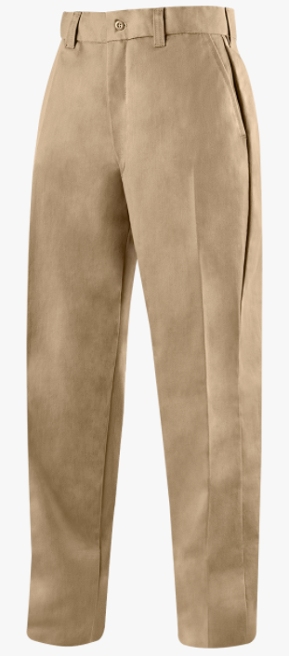




Our Final Solution would be like…
My closet
T-shirt
Click!
WASH SEPARATELY
PROFESSIONAL
DRY CLEAN
RECOMMENDED

Slide 32

How to judge?
Mid. Demo | Final Demo
Accuracy
Limited accuracy (More dataset required)
Double check by users
Latency
Human-unrecognizable Latency (Seamless Service)
Durability
Data persistence on shutdown or crash
-
*
* Durability is only required for user data

Slide 33
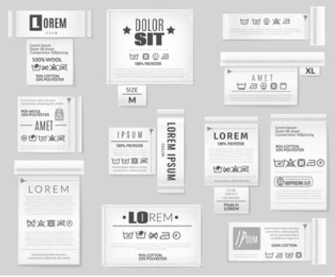
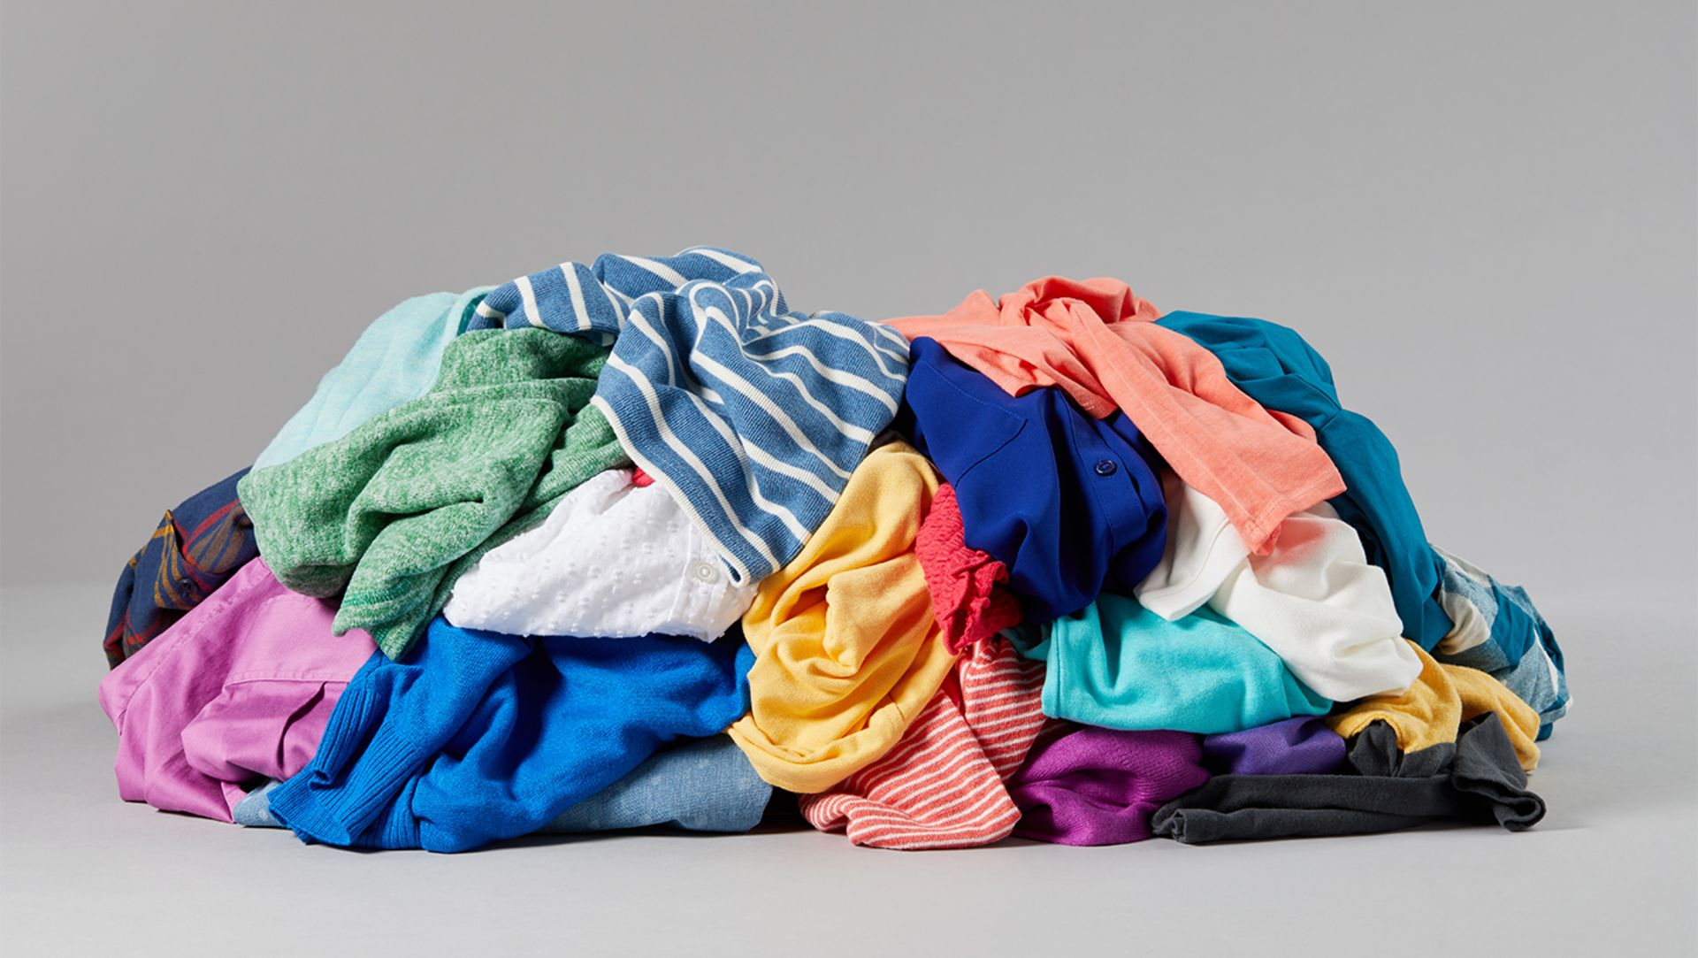
Expected Challenges
Recognizing/extracting laundry symbols in various types of care labels
Building a database for laundry guidance
Developing a model to recognize clothes image

Slide 34
Evaluation Strategy
How accurate our app to
Guide proper information according to each laundry symbol
Match clothes images to laundry symbols stored in DB
How much time our app takes to
Recognize laundry symbols and clothes images
Guide how to laundry
Can our app preserve information after shutdown or crash

Slide 35
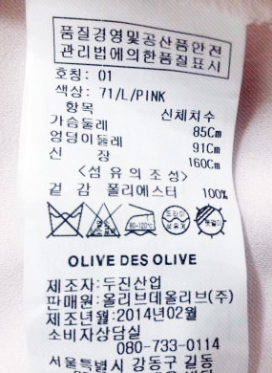
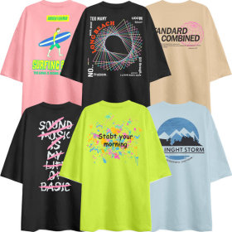

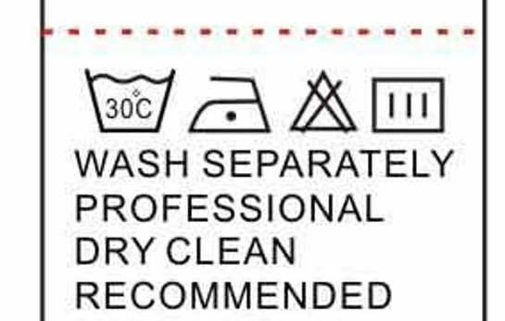
Usage Scenarios
Register Cloth Information
Take a picture of care label and cloth
Get Laundry Guidance
From registered lists
From label image

Slide 36



Key Functions
2. Save and restore recognized care labels in/from DB
Save care label information and picture of clothes
Select one of clothes
Bring laundry tips based on care labels associated with the selected cloth

Slide 37
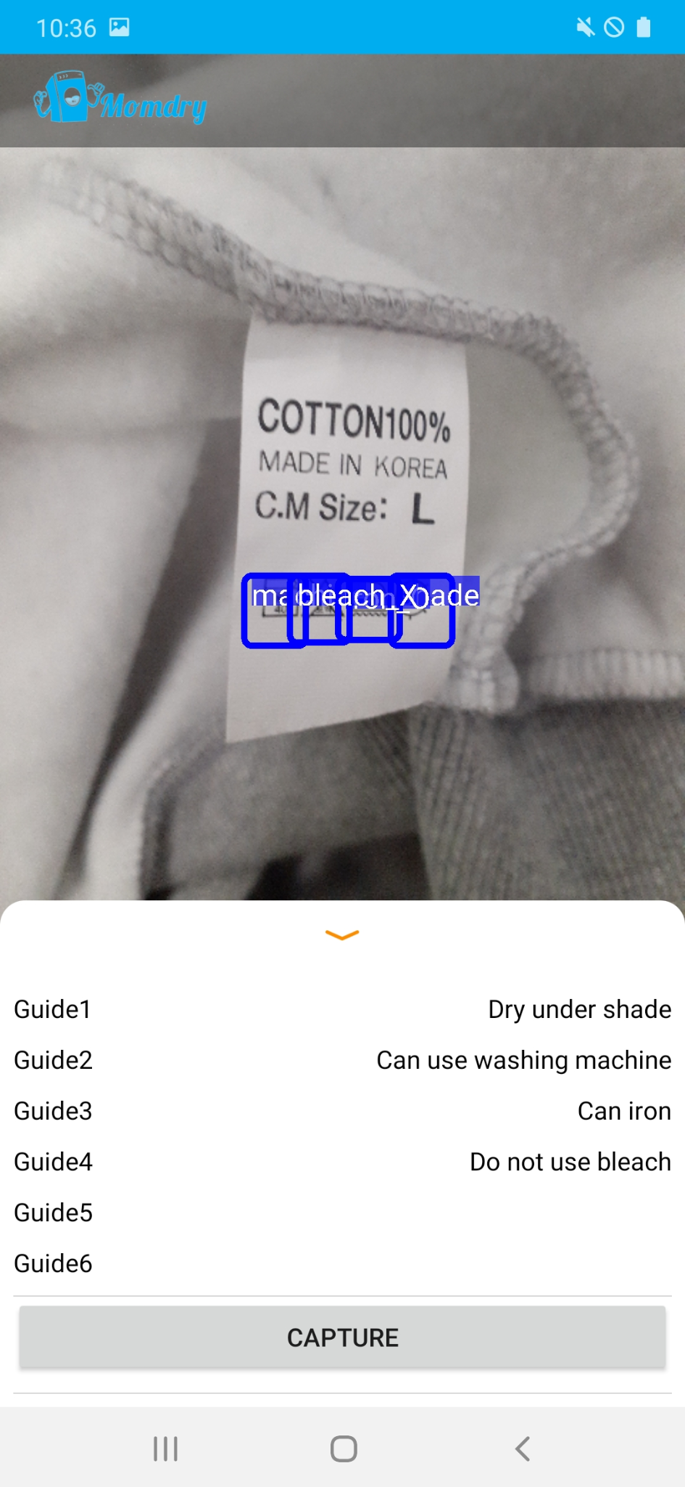
OUR mid project demo
Notes:
This is our demo.
The left picture show

